Slide 1
Oakwood Primary Academy year 1 and 2 ~ Welcome Meeting for Parents September 2021

Slide 2
Staff in Year 1 and 2
Avon Miss Crocker
TA- Miss Solt
Fowey Miss Aquilina
TA Miss Francis Lang
Thames Mrs Tearney and Mrs O’Brian
TA Mrs Widnell

Slide 3
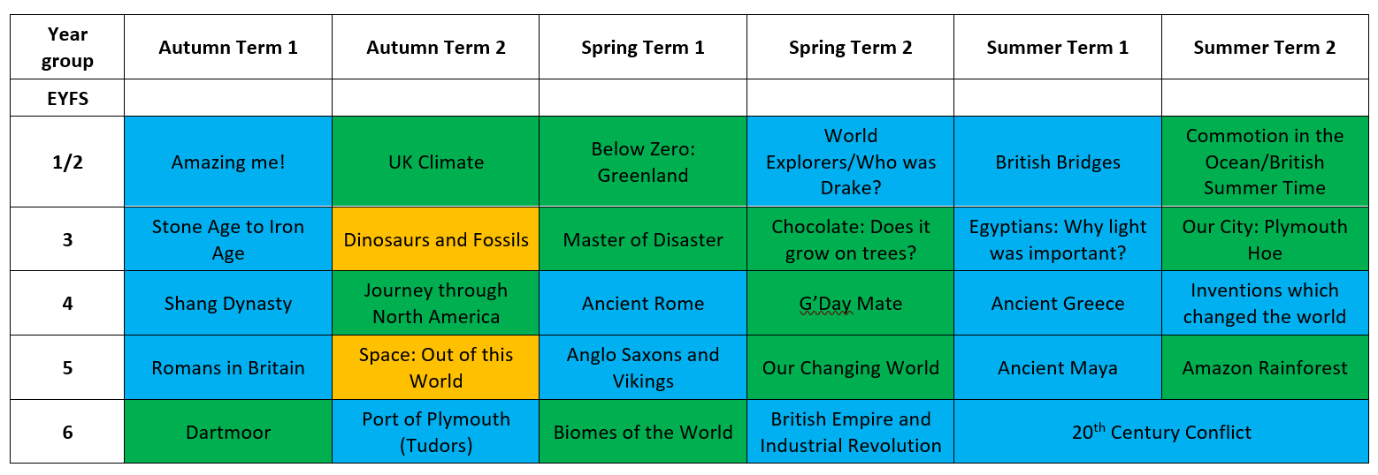
Year 1 and 2 Learning Journey:
All subjects are linked across the curriculum. Your child may also have the opportunity to take part in additional rich experiences such as Forest School and School Trips throughout the school year.

Slide 4
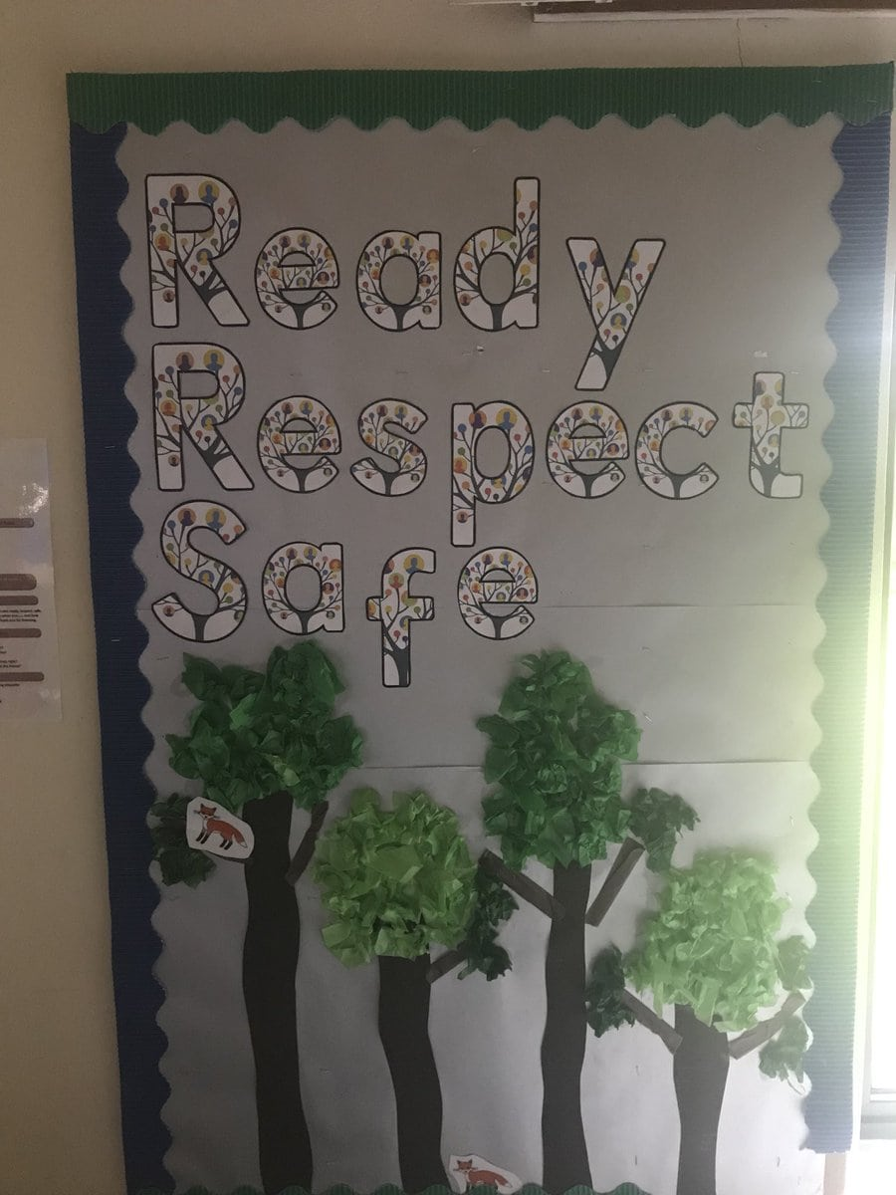
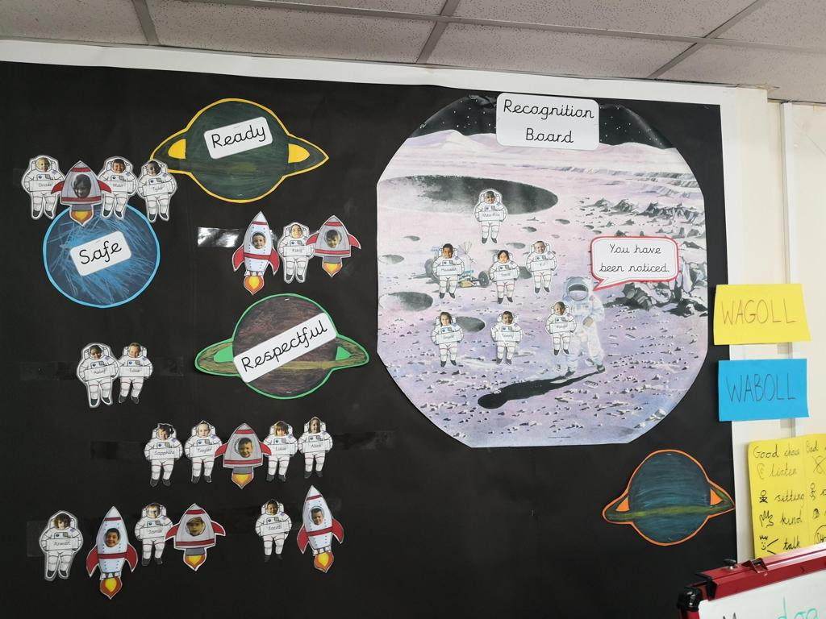
Ready, Respectful and Safe
Recognition Boards

Slide 5
PE Kit (General)
PE Kit - Must be in school every day – it will be sent home at the end of each term (old half term) for washing.
PE kit consists of black/navy shorts, yellow t-shirt/polo shirt, black plimsolls, trainers. Black/navy tracksuit bottoms can be worn in winter. Spare socks and hairbands!
If required for after school clubs, PE kit must be left in school or returned the next day if washing is required.
Earrings must be taken out for PE. They are not to be covered with plasters. Pupils are not allowed to take part in the lesson if they have not taken their earrings out.
Notes:
PE days are Monday and Wednesday

Slide 6
Reading Records
Every child has a reading record, the same as last year.
Please use these to make comments about the books you are reading at home.
Children will record the results of their STAR reading tests and Renn quizzes inside the record to share with parents/carers at home.
Please can all children ensure their parents sign their reading record and hand this to their class teacher every Tuesday.
Children will be taught to read by the Read Write Inc Programme of Ruth Miskin. This is an effective approach to ensure children are gaining skills to decode and build vocabulary.
Notes:
Emphasis the importance of reading at home. Also more information on how to support your child and how RWINc is taught will follow. I am the lead of Rwi and will be on hand to support parents.

Slide 7
Year 2 (only)(SATs)
Children in Y6 will sit their SAT’s (a series of statutory assessments) in the summer term.
Children will sit test papers for:
Spelling and Grammar (a spelling paper and a grammar paper)
Mathematics (an arithmetic test and two reasoning papers)
Reading (one reading paper based on three texts)
Additional information:
Writing skills will be assessed by your child’s class teacher and this may be moderated by the local authority.
We may also be asked to sit a Science assessment (these happen bi-annually).
Results are not usually publishing until July and the school will report these results to you at the end of the school year.

Slide 8
Home School Contact
Throughout the year we will arrange meetings to update you on your child’s progress through:
Parents’ Evenings after School Reports.
IEP review meetings.
You can make an appointment to discuss any other queries via the school office.

Slide 9
Other Admin
Water bottles (sports cap)
Fruit snacks /School dinners / Packed lunches
School uniform (footwear & earrings)
Toys or show and tell objects should not be brought into school.
Morning procedures

